Slide 1

Project 7
Clergy and Laity: Awakening Prophetic Urgency and Agency: Becoming an Alternative Community

Slide 2

Understanding what is expected
I would like us to try and understand the different elements and concepts at play in this Project.
There are many elements that needs to be covered and some of the concepts are not easy to understand
For that Reason, I thought we should start this session by understanding WHAT is expected from us as we work through the Project, but also clarify our own theological understanding of some of the terminology to use.
What is wonderful about this Project is that the Church creates room for both laity and clergy to exercise their gifts and calling
However, our theological understanding will influence the way that we go about assisting each other as clergy and laity to truly become a Priesthood of ALL believers.
There is a danger that we as clergy might feel like we have to carry the load, however, as the Presiding Bishop said, we are to “Become an Alternative Community”, and sorry to say that, but it is not easy to change the mindset of people, not our own nor those of others. Therefore, we have our work cut out for us, in this Project as we start a process that will for many be uncomfortable and can cause some conflict in the process.

Slide 3

Priesthood of All Believers
That is truly a mouth full. But it is jam-packed with theological terms and theological and scriptural support.
Many of us know in our heads what it means “every member ministry”, yet it has not travelled the 30cm from head to heart, which means it has not even started translating into our hands.
Q: Can we unpack this concept of the Priesthood of all believers, please?
For that to happen, we will need to honest in our understanding of each part of the statement, and perhaps move a bit deeper, where it might be uncomfortable for some of us.
Let’s just start, there is no wrong or right answer, however, if you make a statement, I would expect you to be able to substantiate it both scripturally and theological

Slide 4
Unpacking The Priesthood of all Believers
Best way to unpack something like this is to break it down into smaller pieces. May I ask that one of you act as scribe for the answers, please?
Q1: What is a Priest (in your opinion)?
Q2: What then is a Priesthood?
Q 3: Who are considered Believers?
Q4: Why all not some?

Slide 5
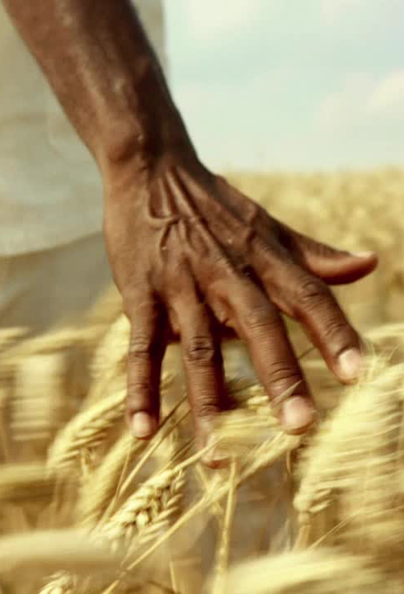
Definition of a Priest
In the Biblical Concept a Priest is a mediator between God and humanity.
Responsible for offering
Sacrifices
Prayers
Praises
On behalf of the people
In the OT, priests were primarily from the tribe of Levi, specifically the family of Aaron (Exodus 28:1; 40:15)
At the time, Priests were mainly men

Slide 6
Priest in the New Testament
Interestingly enough, Jesus never referred to himself or any of His Disciples as a Priest in any of the Gospels.
It was in the Epistles that the realization came that Jesus is BOTH Priest/High Priest as well as the Sacrificial Lamb. (Hebrews 4:14-16)
Jesus, rather takes His role as a Priest as something that is seen in His actions and teachings rather than seeing it as a position of power.
He lived, knowing that he is the sacrificial lamb that takes away the sins of the world.
His life, death and resurrection was His Priestly role, a life of unique obedience and devotion to God and humanity, that was more important than a title.
And in his actions, the community saw that Jesus was indeed not only the lamb but the high priest. But unlike the high priests of His time, He saw his function not as a position of power and influence, stuck in tradition and within a institution, temple or synagogue. To be a priest, meant to live in a sacrificial, serving way, rather than from “the top”.
It was only after the resurrection that the disciples realised that to BE a priest, meant to LIVE a sacrificial life. One of obedience and devotion to God and humanity.

Slide 7
Jesus as Priest and Sacrifice
While Jesus does not explicitly refer to Himself as a priest in the Gospels, there are hints of His priestly role:
Jesus says, “The Son of Man did not come to be served, but to serve, and give his life as a ransom for many” (Matthew 20:28); suggesting Jesus’ understanding of His role as a servant and sacrifice.
Jesus says: “I am the good shepherd. The good shepherd lays down his life for the sheep” (John 10:11) implying Jesus’ willingness to sacrifice Himself for the sake of others.
During the Last Supper, Jesus institutes the Lord’s Supper, saying “Tis cup is the new covenant in my blood, which is shed for you”. (Matthew 26:26) acknowledging his understanding of His role as a sacrifice and mediator of the new covenant.
While Jesus does not explicitly claim the title of priest in the Gospels, His actions and teachings imply a deep understanding of His priestly roll as a mediator between God and Humanity.
Before His ascension He passes that “role” onto his disciples, “Go out and make disciples (people who will be mediator between God and Humanity, to serve and sacrifice, to teach and heal”
Jesus is described as the high priest, who entered the heavenly tabernacle, offering Himself as a sacrifice to obtain eternal redemption (Hebrews 9:11-14)
Jesus is said to have offered ONE sacrifice for sins (NB), and then sat down at the right hand of God (Hebrews 10:12)
Jesus is described as the high priest who does not need to offer sacrifices daily, because He offered Himself as a sacrifice for all (Hebrews 7:27)

Slide 8
Priesthood
Being in a Priesthood – means you are not alone. You are serving and sacrificing, mediating and teaching etcetera with OTHER Priests.
We all know 1 Peter 2:9: “But you are a chosen people, a royal priesthood, a holy nation. God’s special possession, that you may declare the praises of him who called you out of darkness into his wonderful light”.
It is here where we get the true understanding of Priesthood. It is a gathering of believers, who share the responsibility to mediate between God and the world.
This concept already started in the OT, but through Christ it was fulfilled.
At first the priesthood was limited to the tribe of Levi. However, as the Israelites’ relationship with God evolved, we see glimpses of a broader understanding of priesthood.
In Exodus 19:6: God describes the Israelites as a kingdom of priests” in the context of the Sinai covenant.
In Isaiah 61:6: The prophet Isaiah foresees a future where all Israelites will be priests, serving God and receiving blessings”

Slide 9
Priesthood expanded in OT
In both the OT and NT we see that priests NEVER worked or served alone. They were assisted by non-priests, such as:
Various tasks including music, gatekeeping, and maintenance (1 Chronicles 6:31-32; 9:17-27).
Helped with cleaning, maintenance and sacrifice preparations (2 Chronicles 35:1-9)
Deacons assisted the apostles and other leaders with practical tasks, such as caring for the poor and managing resources (Acts 6:1-6)
The concept of Priesthood of all believers is not a new concept, it is just more amplified through the life of Christ.

Slide 10
Priesthood in NT – ALL BELIEVERS (Not Just Some)
In the NT, Jesus Christ is seen as the ultimate High Priest, who offers Himself as a sacrifice for humanity’s sins (Hebrews 4:14-16; 5:1-10).
Through Christs’ sacrifice, the distinction between priests and non-priests is abolished, and ALL believers become a part of this royal priesthood. (1 Peter 2:9; Revelation 1:6).
Paul also says that: “So in Christ Jesus you are all children of God through faith, for all of you who were baptized into Christ have clothed yourselves with Christ. There is neither Jew nor Gentile, neither slave nor free, nor is there male and female, for you are all one in Christ Jesus. If you belong to Christ, then you are Abraham’s seed, and heirs according to the promise”. (Galatians 3:26-29)

Slide 11
Believers in Scripture and John Wesley’s Theology
Q1: What is John Wesley’s theology around the concept of the Priesthood of Believers? Can someone again take some notes please?
Q2: What is the difference between the Priesthood of Believers and making disciples?

Slide 12
Believers in Scripture and John Wesley’s Theology
In Scripture, believers are described as those who have put their faith in Jesus Christ and are being transformed by the power of the Holy Spirit (Roman 1:16-17; 2 Corinthians 3:18).
Wesley emphasized the importance of believers living out their faith in practical ways, both personally and corporally. Knowing that if one part of the body suffers, the whole body suffers and if one part is honoured, all the parts are glad (1 Corinthians 12:26).
John Wesley’s theology was always Scripturally supported and as such he emphasised the importance of:
Personal Holiness: Believers should strive for moral purity and spiritual growth
Social Justice: Believers should work towards creating a more just and equitable society
Evangelism: Believers should share the Gospel with others, inviting them to experience the transformative power of Christ

Slide 13
Wesley’s link between Priesthood and making Disciples
Wesley believed that EVERY Christian is a priest, called to minister and serve others, rooted in 1 Peter 2:9
His emphasis on the Priesthood of all believers, meant that EVERY Christian is a minister
This understanding democratized ministry, recognizing the ALL believers have a role to play in advancing the Kingdom of God.
In this context, then, making disciples was not just about evangelism or conversion, but about empowering believes to live out their faith in practical ways.
For him, the Priesthood and discipleship were intertwined, all leading to cement the individual’s faith and practices but in the process expand the Kingdom through their gifts and talents, serving others in various ways.
This approach meant the emphasis was for each believer to be
Faithful in spiritual practices
Accountable to other believers
That leadership development was important to all believers
All of his theology and practices were designed to help believers grow (together) in their faith and become more effective ministers.

Slide 14
Mutual Accountability and Support
With Wesley’s understanding of the Priesthood and the path of the disciple, it becomes clear that their must be an emphasis on the importance of mutual (not top down, or bottom up) accountability and support.
Believers were encourage to meet in small groups, such as
Class Meetings
Bands
To share their experiences
Correct each other in their behaviour
Expand their own knowledge
Assist in their respective ministries
Receive guidance
In this way, they held each other accountable to ensure, the Gospel is not tainted

Slide 15
Equipping for Ministry
Wesley’s emphasis on the Priesthood of Believers, meant that every Christian was equipped for ministry. Equipped with the:
Support of other believers
Skills
Knowledge
Spiritual gifts
Area of influence
To minister effectively, whether in their local community or the wider world
Wesley’s approach was to empower and equip every believer, to form disciples that are Priests to minister and serve others.
Discipleship is the core of the Priesthood of Believers.
It is a process of transformation (sanctification)
A Crucial aspect of Christian growth and maturity)
Where individuals would become more like Jesus Christ, and live their faith out as priests in a practical, alternative way that honoured and obeyed God.

Slide 16
conference Theme: Awakening Prophetic Urgency and Agency
Have you ever delved into the profoundness of this theme?
Have you noticed that the Presiding Bishop has a clear focus for her term?
Have you realised that the sub-themes, build on each other?
If not, why not?
The PB is the leader of this church. She is God-appointed and God-anointed for such a time as this.
While we might not always agree with her, we do however, have to obey and follow her leading in our own leadership

Slide 17
Awakening Prophetic Urgency and Agency
2023
Reviving the Church of Christ
2024
Becoming an Alternative Community
2025
What is the next step?

Slide 18
Unpacking Prophetic Urgency and Agency…
The conference address explores the concept of “Awakening Prophetic Urgency and Agency” within the context of Wesley’s theology
Prophetic Urgency refers to the sense of urgency and responsibility to:
speak truth to power
Advocate for justice
Promote transformation
Prophetic Agency, is the ability and authority of believers to act as:
Agents of change
Exercising their gifts and talents
To serve and transform their community
Now in light of that understanding, what then did you do last year to Revive the Church of Christ?
Without that crucial building block, we will not be able to become an alternative community

Slide 19
Prophetic Urgency and Agency…
Refer to the sense of:
moral imperatives
Practical application
And capacity to:
Act decisively in creating firstly a revival in the Church
And then acting intentionally to create an alternative community.
A dead Church cannot be an alternative community
First Revival…then alternative community. The building blocks of our Presiding Bishop’s Vision

Slide 20
Prophetic Urgency
A sense of moral imperative (a sense of life and death). Recognizing the need for moral change and feeling compelled to act and show people the way of God
Critical awareness: understanding the injustices, inequities, and the flaws in our existing systems.
Vision for a better, morally sound, and equal future: Imagine a more just, morally sound, equitable and compassionate community

Slide 21
Prophetic Agency
Capacity for action: There is not urgency if no agency. It is time to step into the power, resources and support to effect change
Decisiveness and courage: Taking bold, informed, and values-driven decisions to challenge the status quo. Firstly in our Church, then the rest.
Collaboration and solidarity: If we start thinking in terms of an alternative community, then we will start building alliances that cross cultures, race, economy and working collectively with others to create a more just and equitable community.

Slide 22
Creating an Alternative Community
In creating an alternative community, building on the fire of a revived church, prophetic urgency and agency involve:
Challenging dominant narratives: Questioning and countering harmful ideologies, practices and power structures
Building alternative institutions: Establishing new systems, organizations, and social structures within the Church that embody our Christian values, justice, equality, and compassion
Empowering marginalized voices: Amplifying and centering the perspectives and leadership of those most impacted by injustice.
Fostering a culture of solidarity within the MCSA: Cultivating a sense of our call, our mission, our shared humanity, our mutual support and accountability, to our collective responsibility to be the Church Christ prayed for.
If we do not embrace the theme of prophetic urgency and agency, and if we refuse to work together as individuals, then we will be like the rest of the world.
It is only if we work together that we can create alternative communities, starting in our churches, communities, that break down barriers, that hold tight to high moral values, that reach out to the marginalized to create a community full of Priests that are more just, more equitable, and more compassionate

Slide 23
So What??
What then does all of this have to do with the Priesthood of all Believers?
Why should we even try to be an alternative community?
Do you know how much conflict this can and will create?

Slide 24
The “end of Discipleship: John Wesley’s Vision of Real Christianity
In the Book edited by Mark Greene & Tracy Cotterell: “Let my people grow: making disciples who make a difference in today’s world”, there are a few chapters that really stood out for me.
Chapter 5 is written by Philip, R. Meadows (There is a reference list at the end of the presentation, with links and suggested additional readings)
He asks the question: “Why would twenty-first-century Christians turn to an eighteenth-century Anglican pries for inspiration about mission, evangelism and making disciples in our contemporary culture?”
Valid questions, perhaps a question all of us at some point in our ministry have asked.
But, if we proclaim that we are Methodists, following Wesley’s theology, we will have to delve deep into his theology and his practices to truly see the beauty of his understanding of being an alternative community

Slide 25
Method in Wesley’s “Madness”
The answer lies in the reality that Wesley had a vision, of an alternative Church community
He started by Reviving the Church
Then in the process built and alternative community
One who grew from a handful of students to an international denomination, that followed his theology of building Christians into a Priesthood of all believers, making disciples that changed the course of history.
Now THAT brings the Presiding Bishop’s conference theme into perspective, does it not?
Because”…the heart of what Wesley has for us today lies in his compelling vision of the Christian life itself. It was his vision of forming a holy people capable of being a living witness to the Gospel in uncertain times, that capture his imagination and directed his own search for “whole-life discipleship”,

Slide 26
Observers or Participations
We can dream of Wesley’s life as an example of Christian leadership
We could examine his career as an itenerant evangelist
We can study his vocation of proclaiming the Gospel, and planting Christian communities among “unchurched” people
We can remember his reliance on the supernatural power of the Holy Spirit, charismatic preaching for creating a revival and making disciples
He was obsessed with the early church and “primitive Christianity” seeing them as the precursor to a church movement with radical and emerging theology and churches
We can envy his organisational genius on how to gather and connect people to small groups and societies, binding them together in communion with each other and in service to the community.
“Or we could regard his commitment to mutual accountability in the formation of disciplined Christian fellowship as a model for making disciples”.

Slide 27
Unbecoming to Become
In her address the Presiding Bishop clearly lays out the Marks of Being An Alternative Community. I will not go through them, we all have access to them.
It is the Unbecoming to Become section that this Project is focussed on. Again, this is for your own reading. Yet it sparks a few questions, especially in relation to the Priesthood of All Believers.
For us to unbecome, we need to know the state of our own lives, our society, our community. Again, only you can be honest about this.

Slide 28
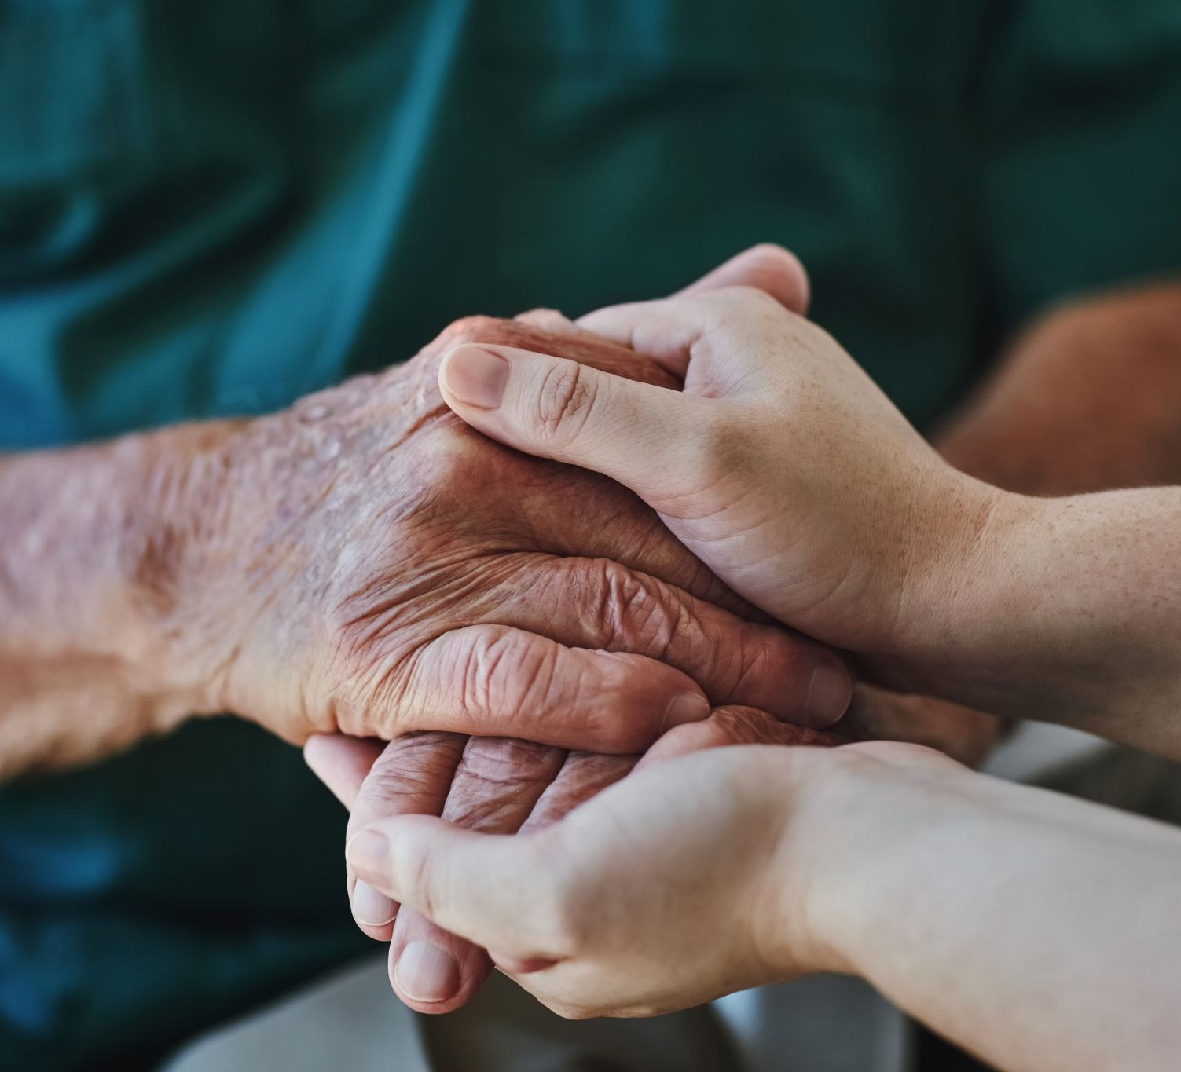
Becoming an Alternative Community
Counter-cultural living: The Presiding Bishop wants the church to embody alternative values, such as:
accepting and encouraging Women in Ministry across the Connexion.
Simplicity
Generosity
Inclusivity
Willingness to be selfless
Sacrificial living

Slide 29

Becoming an Alternative Community
Intentional Community: The church should foster a sense of intentionally being an alternative community, where members:
Support
Care for
Learn
Guide
And hold each other accountable

Slide 30
Becoming an Alternative Community
Demonstrating God’s Kingdom: The Presiding Bishop encourages us as the priesthood of believers to demonstrate the values and principles of God’s kingdom, such as:
Love
Justice
Humility
Mercy
In practical, and tangible ways

Slide 31
Priesthood of All Believers: Role of the Clergy
Your role as Clergy is multifaceted: You will have to be the driving force, the one who takes the conflict head on, the one who leads by example.
Part of your role will have to be Equipping and Empowering:
Equip believers for ministry. Clergy should provide training resources, and guidance to help believers see the possibility of an alternative community, by helping believers identify and develop their spiritual gifts and talents
Empower believers for service: Clergy should encourage and empower believers (and hold them accountable) to serve others, both within and outside the church
Another is Leadership and Guidance
Provide Spiritual Guidance: Clergy should offer spiritual direction, counsel and support to help believers navigate their faith journey
Model Christian leadership: Live what you preach. Clergy should demonstrate in every aspect of their lives, that they are Christian leaders, living by exemplifying biblical values, integrity, and humility

Slide 32
Priesthood of All Believers: Role of the Clergy
Facilitating Community and Accountability
Foster a sense of community: Clergy should create a sense of belonging, being welcomed and connected among believers, encouraging them to support, guide and hold one another accountable.
Establish accountability structures: Clergy should establish systems of accountability, such as small groups or mentoring relationships, to help believers stay on track in their spiritual journey
Encouraging Spiritual Growth
Teach and Preach: Preach and teach the Word of God (not what you think they should hear, but to tell them the truth about what it means to be a disciple), helping believers to understand and apply biblical principles to their lives
Encourage spiritual practices: Tell them your own discipline in spiritual practices such as prayer, fasting, Bible study, helping believers to deepen their relationship with God

Slide 33
Priesthood of All Believers: Role of the Clergy
Ask the hard questions: Firstly, of yourself – this is often where we as Clergy fail, we think we are “holier” because of our Status. When last have you asked yourself or was asked these questions and could honestly answer them?
What known sins have you committed since our last meeting?
What temptations have you met with?
How were you delivered?
What have you thought, said, or done, of which you doubt whether it be sin or not?
Have you nothing you desire to keep secret?

Slide 34
Priesthood of All Believers: Role of the Clergy
Empowering Discipleship:
Identify and develop leaders: recognize and develop the leadership potential of all believers, empowering them to become disciple-makers
Multiply disciples: Encourage and equip all believers to make disciples, multiplying the impact of the church
You set the example:
Your leadership will either equip, empower, guide and build believers
They will follow your lead as long as it is true, trustworthy, authentic, humble
If you are a mature disciple, you will help believers become mature disciples who make a positive impact on the world

Slide 35
Empire or Kingdom: The Dilemma Clergy Face
The collar you wear “sets you apart”. But for what?
Building your empire?
Power?
Money?
Abuse?
Hierarchy?
Institutional protection?
Status?
Superior training and education?
We all understand that we are all called into the body of Christ with different callings and different gifts, but we should be convinced that we are all equal within the body of Christ, and only once clergy accept this understanding, out real expression of the Kingdom of God in our world will lead to a truly, powerful Priesthood that can impact the world.
A lot of expectations are placed on us, yet, our role is to lead and follow at the same time. Not an easy balance
And I know laity can be difficult, but…Jesus took a bunch of rough people and loved them into being devout disciples.

Slide 36
Priesthood of All Believers: Role of Laity
Exercise their prophetic voice, speaking truth to power and advocating for justice (Micah 6:8).
Utilize their gifts, skills, and experiences to serve and transform their communities (1 Corinthians 12:4-6).
Hold clergy accountable for their actions and teachings, ensuring they remain true to the Gospel (Matthew 18:15-17).
While collaborating to awaken prophetic urgency and agency, respect for clergy is important.
Build up others
Reach out and Reach in

Slide 37
Pitfalls for Laity
Abdicating their responsibilities, relying solely on clergy for spiritual guidance and direction.
Undermining clergy authority, neglecting the importance of spiritual leadership and guidance.
Vying for power, position, playing politics rather than being disciples and making disciples
Pointing fingers, avoiding being held accountable
Using Church processes to trip up clergy and others

Slide 38
John Wesley: Three-Stand Discipleship Process
The single greatest weakness in Church is that supposed members are not really involved in Church, and think it not strange that they are apathetic to involvement. And those who are involved, want to dominate☺
MCSA identifies and recognize Christ’s intention to make His Church a militant company as what is “conventional” is not enough.
If 90% of our membership/soldiers are not trained or involved, the battle will be lost.
Wesley developed a simple plan for maturing and equipping believers, founded on Jesus’ way for discipleship
Three-Strands of Gospel: Crowd+Cell+CORE=Church
Three-Strands of Growth: Christ+Clergy+Laity=Church

Slide 39
Four Basic Principles of Discipleship
Discipleship hinges on four basic principles
The Necessity of Discipleship: Wesley wrote: “I am more and more convinced that the devil himself desires nothing more than this, that the people of any place should be half-awakened and then left to themselves to fall asleep again”
The Necessity of Small Groups: In 1743 Wesley organised a society having the form and seeking the power of godliness, discipline was key, united in order to pray, receive the word, watch over one another in love, to help each other work out their salvation.
The Necessity of Leadership: “Give me one hundred preachers who fear nothing but sin, and desire nothing but God, and I care not a straw whether they be clergy or laymen, such alone will shake the gates of hell and set up the kingdom of heaven upon earth.”
Holiness and Service: become like Jesus and do what he did

Slide 40
The End Product of Disciple Making: Holiness
Holiness and Justice
We all know the Methodist tradition of using Wesley’s phrase “there is no holiness but social holiness”
Yet, the interrelationship is unclear. For me, it creates the possibility that one can be personally holy without being socially holy or vice versa.
The end product of Disciple making is always love! Wesley’s interpretation of holiness was an issue of love.
But what does this even mean in regard to the Priesthood of all believers: Well…
“Nothing higher and nothing lower than this the pure love of God and man – the loving God with all our heart and soul, and our neighbour as ourselves. It is love governing the heart and the life, running through all our tempers, words and actions”
The questions you have to ask – Do I LOVE those I serve with? Do I LOVE those I lead? Do I LOVE all I encounter?

Slide 41
THE MCSA’S Seven Transformational Goals
In the MCSA there 7 transformational goals that guide our work or at least that should guide our work. Included in those transformational goals are the following two:
A rediscovery of the Priesthood of all believers
A redefinition and the authentication of the vocation of the clergy in church
Goals are not simple statements; they are WHAT WE BELIEVE GOD CALLS US TO BECOME
What is interesting is that our church believes that these two things must and can happen at the same time, this therefore means that we fundamentally believe that laity and clergy, both vocationally and voluntarily have an integral role to play in the revival of our church and becoming an alternative community. Strange how we think of ourselves in silos, when in fact our roles are to hold together believers in a way that both compliments and challenge; is separate but has the same goal; lines are blurred, yet roles are defined. This is the beauty of a complex church and society that creates room for both laity and clergy to exercise their gifts and calling.

Slide 42
The Final Realization
In practice, becoming an alternative community, using Wesley’s understanding of the priesthood of all believers has been difficult to realize because of the sharp distinction between clergy and laity.
To make the priesthood of all believers a reality, clergy may need to be more open to shared leadership and listening.
Laity may need more training and equipping to participate fully.
In the words of Jesus in Matthew 9:35-38: And Jesus went throughout all the cities and villages, teaching in their synagogues and proclaiming the gospel of the kingdom and healing every disease and every affliction. When he saw the crowds, he had compassion for them, because they were harassed and helpless, like sheep without a shepherd. Then he said to his disciples, “The harvest is plentiful, but the labourers are few; therefore pray earnestly to the Lord of the harvest to send out labourers into his harvest.”

Slide 43

Questions?

Slide 44

Let’s look at Project 7

Slide 45
Resources
Art, L., 2013. The Priesthood of all Believers. The Institute for Faith, Works and Economics.
Greene, M. & Cotterell, T. (., 2006. Let my people Grow: Making disciples who make a difference in today's world. Milton Keynes: Authentic Media.
Hudson, N., 2012. Imagine Church: Releasing Whole-Life Disciples. Nottingham, England: Inter-Varsity Press.
W'Ehusha, L., 2014. Redeeming the Priestly Role of Theology for the Land of Africa. Old Testament Essays, Volume 27(Issue 1), pp. 302-317.
Thoughts on Christian Perfection in Wesley 2013, pg 63
https://corediscipleship.org/john-wesley-3-strand-discipleship-process/
https://discipleship.org/blog/the-end-product-of-disciple-making/#:~:text=He%20wanted%20people%20to%20be,church%20and%20every%20disciple%2Dmaker.
https://renovare.org/articles/the-new-testament-picture-of-discipleship#:~:text=Dallas%20tells%20us%20that%2C%20if,%2C%20character%2C%20and%20abilities.%E2%80%9D
https://ministryarchitects.com/stages-in-discipleship-development-a-well-established-concept/#:~:text=It%20consisted%20of%20four%20stages,level%2C%20and%20multiplying%2Dlevel.
chrome-extension://efaidnbmnnnibpcajpcglclefindmkaj/https://place.asburyseminary.edu/cgi/viewcontent.cgi?article=2456&context=asburyjournal

